Slide 1
Predictive Modeling
Decision Trees
Ensembles: Bagging and Boosting

Slide 2
Decision trees
What is it?
A systematic approach to segment the space of your predictors into a number of simple regions:
we use if-then statements to define patterns in data
We understand average behavior/response of each region (using mean or mode)
Then we classify the region with a single dependent variable label
We will then have a tree for predictions
?
Why use it?
Output is highly visual and easy to interpret
Neither linearity of relation nor independence of parameters is required
When to use it?
When you have a clear hypothesis about what to solve for
Prediction of segment-specific customer behavior (e.g., buying decisions, churn rate, consumption rate)
SOURCE: McKinsey Analytics Practice

Slide 3
Decision trees
Start from the root of tree
P(-) = 16/30 ≈ 0.53
P(+) = 14/30 ≈ 0.47
?
:14
Refund
:16
Yes
No
+
Marriage status
Yes
No
Married
Single, Divorced
?
-
TaxInc
:1
:13
<80K
?
>80K
:12
:4
-
+
P(-) = 12/13 ≈ 0.92
P(+) = 1/13 ≈ 0.08
P(-) = 4/17 ≈ 0.24
P(+) = 13/17 ≈ 0.76
Which variable decreases the “entropy”?
SOURCE: Data Science for Business by Foster Provost and Tom Fawcett, 2013. Page 54.

Slide 4
Basic principles of decision trees
The first statement is a fork – it splits the data into two branches based on some value of a particular variable
The value between the branches is called a cut point. Observations to the left of point get categorised one way, while those to the right in another way
At the best split, the results of each branch should be as pure as possible (cf. node impurity measures)
Algorithm repeats the process above on subsets of the observations – called recursion
Additional forks add new information (predictors) that can increase a tree's prediction accuracy
Final tree branch ends are leaf nodes or terminal nodes. Our decision tree models classify observations based on which dependent variable is majority (for classification problems) or the mean/mode (for regression problems)
SOURCE: McKinsey Analytics Practice

Slide 5
There are different techniques to decide on the “best split”
Regression problems
Residual sum of squares (RSS) – sum of squared error differences between the predicted values and actual values – to split at each node
Cost complexity pruning: Weakest link pruning based on tuning parameter α that controls trade-off between sub-tree’s complexity and fit to training data
Classification problems
Splitting techniques
Classification error rate – Fraction of training observations in a region that don’t belong to the most common class
Gini index – Measure of total variance among the K-classes
Cross entropy – Similar to Gini index numerically
Heuristic: Prefer attribute that produces the “purest” sub-node (least impurity) and leads to the smallest tree
Gini index/cross entropy preferred for splitting as more sensitive to node purity
Classification error rate preferred for pruning if prediction accuracy is final goal of pruned tree
SOURCE: McKinsey Analytics Practice

Slide 6


Decision trees typically outperform in non-linear situations and are highly interpretable
Strengths
Challenges
Can outperform classical approaches, if there are highly non-linear/complex relationships
Generally highly interpretable and easy to explain
Provide visualisations and graphical representation
Potentially more closely mirror human decision-making
Can handle quantitative predictors without need for dummy variables
Non-robust – small data change can cause large change in final tree
Top-down, greedy approach – recursive binary splitting (makes best split at each step without looking ahead) – can prevent ‘edge solutions’ from being picked up
Overfitting is a common problem and needs to be watched out for
SOURCE: McKinsey Analytics Practice

Slide 7
Improve model performance by combining multiple models into ensemble
Original Data
Subset 1
Subset 2
Subset 3
Ensemble of Models

Slide 8
Improve model performance by combining multiple models into ensemble
New data
A new data point (future data)
Like a new Titanic passenger
Combine a bunch of independent models together
Can be any type of algorithms
Prediction 1
Prediction 2
Prediction 3
Vote for classifiers
Average for regression
Vote
Prediction of the Ensemble

Slide 9
Bagging vs. Boosting
Single
Bagging
Boosting
…
…
1 iteration
Parallel
Sequential

Slide 10
Bagging vs. Boosting
Single
Bagging
Boosting
Train
Evaluate
Y
N
Keep?
Train
Train
Repeat i
Keep
Keep
Set weight for learner i
Update samples’ weights
Train & keep
Train & keep
Train & evaluate

Slide 11
Bagging explained
Original data
Sampling with replacement
Each bag contains variations of the original datasets
In turn this will result in different trees
Bag 1
Bag 2
Bag 3

Slide 12
Bagging explained
Original Data
Create a projection of the dataset sampled with replacement
Each bag is randomly different, producing different trees
Bag 1
Bag 2
Bag 3
Build a tree out of each bag
Combined Ensemble of Models

Slide 13

Bagging is good for you
Reduces variance in estimate
Prevents overfitting
Robust to outliers
Single learner
Ensemble

Slide 14
Random Forests are an ensemble model of multiple trees
Tree 1
Tree 2
Dataset
Dataset
Tree 3
Tree 4
Printed
Dataset
Dataset
Traverse each tree and at each node in a tree
Select m random predictor variables from available set
Use the variable with best split (use objective function)
Move to next node in tree
SOURCE: http://www.slideshare.net/eoinbrazil/introduction-to-machine-learning-using-r-dublin-r-user-group-oct-2013

Slide 15
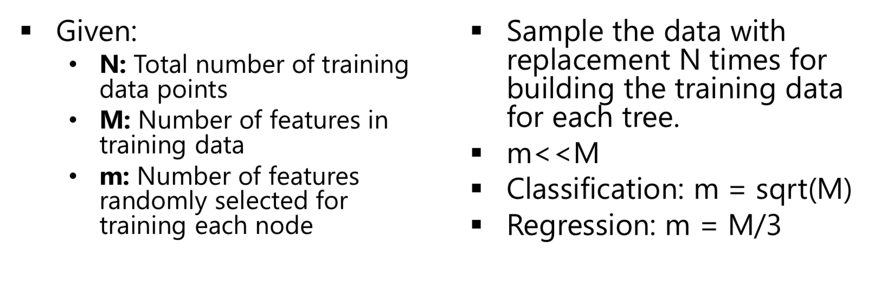
Rule of Thumb

Slide 16
Learning a forest
Dividing training examples into T subsets improves generalization
Reduces memory requirements & training time
Train each decision tree t on subset It
Same decision tree learning as before
Multi-core friendly (GPU implementation)

Slide 17
Boosting
An iterative procedure to adaptively change distribution of training data by focusing more on previously misclassified records
Initially, all N records are assigned equal weights
Unlike bagging, weights may change at the end of boosting round

Slide 18
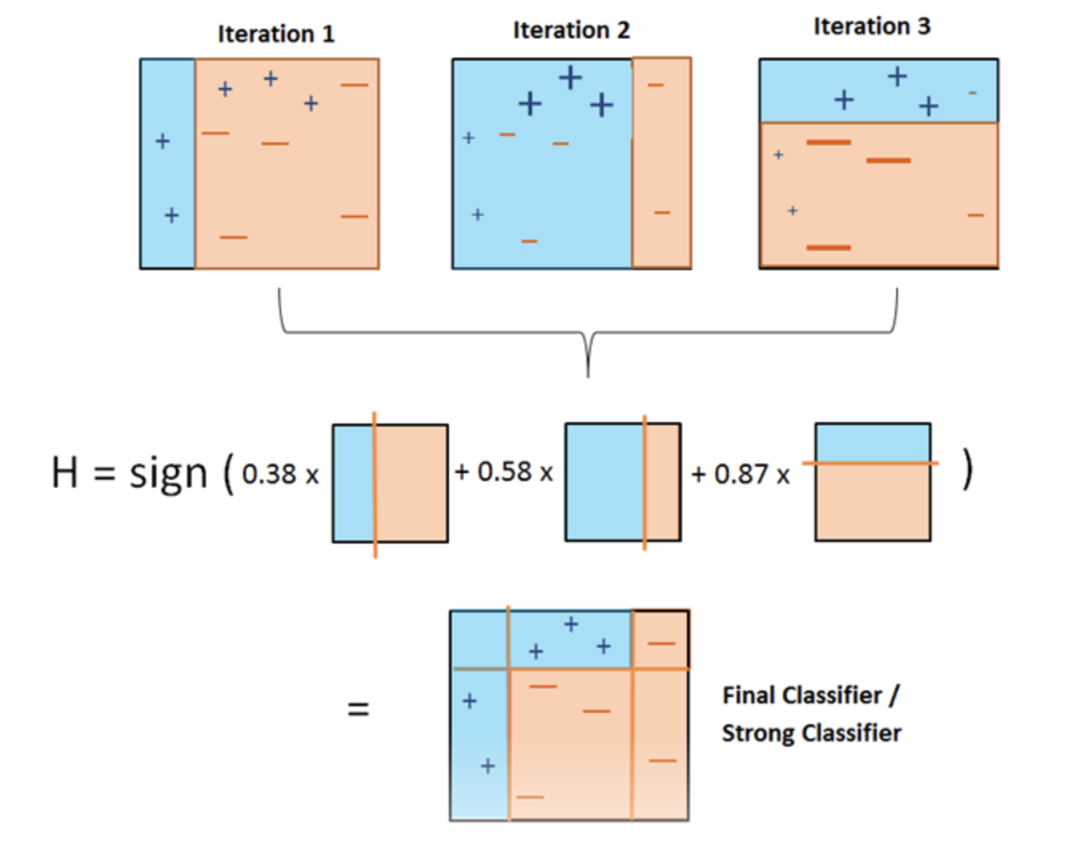
Boosting explained

Slide 19
Boosting Intuition
We adaptively weight each data case.
Data cases which are wrongly classified get high weight (the algorithm will focus on them).
Each boosting round learns a new (simple) classifier on the weighed dataset.
These classifiers are weighed to combine them into a single powerful classifier.
Classifiers that obtain low training error rate have high weight.
We stop by monitoring a hold out set.

Slide 20
There are dozens of us
AdaBoost (Adaptive Boosting)
Gradient Boosting
XGBoost (Extreme Gradient Boosting)
Catboost
Less popular
BrownBoost
LogitBoost

